Slide 1
Unit 2 - Lecture 14
Finding optimal paths
Branch and Bound
Dijkstra's Algorithm

Slide 2
Finding optimal paths
Heuristic functions use domain knowledge to direct the search process towards the desired goal.
The objective of using a heuristic function is efficiency of the solution finding process.
The solution that a search process returns may itself have a property or quality that may be of interest.
That is the cost of executing the solution.
This cost is something that we may want to minimize.
For example, in transportation to, say Mars, each trip will have an associated cost, which is quite significant.
Or the different operations that go into acquiring components and assembling a product would each have an associated cost.

Slide 3
Optimal solutions would be needed, especially if the solution found has to be executed many times.
In such a case, the primary concern would be solution quality, and the speed with which the algorithm finds the solution could be secondary.
While the number of moves that make up the solution is often a good measure of cost, it may become inappropriate when different moves have different costs associated with them.
For example, you may have to change a couple of buses to reach a destination.
This would count as two or three moves.
Hiring a cab may accomplish the journey in one move, but is likely to be more expensive.

Slide 4
The optimization community refers to the property that we seek to minimize as the objective function.
In general, optimization can be a computationally hard problem.

Slide 5
Branch and Bound
The intuition behind Branch & Bound (B&B) is as follows.
Organize a search space that does not exclude any solution. This could be the state space, in which a partial sequence of moves is extended in each move. This could also be a refinement space in which an abstract solution is refined.
Continue looking for a solution by refining the cheapest candidate until
A complete solution is found
No candidate solution, partial or complete, with an estimated cost smaller than that of the complete solution exists
A high level algorithm is given in next slide.
Here the task is to find the lowest cost path from a start node to a goal node, and the algorithm extends the cheapest cost partial solution at each stage.

Slide 7
The basic idea behind B&B is to ignore those regions of a search space that are known not to contain a better solution.
Let us look at an example in which the cost of a move corresponds to the length of an edge in a graph.
Then the least cost solution corresponds to the shortest path in the graph.
Let the graph in figure in next slide represent a tiny search space to illustrate the algorithm.
B&B begins with the start node S.
The partial cost of S is zero.
It expands S, generating partial paths S-A with cost 3, S-B with cost 4 and S-C with cost 8.

Slide 9
S is transferred to list CLOSED, shown shaded in figure in previous slide.
B&B continues extending the cheapest partial path.
It terminates when the goal node is picked for expansion.
The example in that figure shows Branch & Bound extending partial solutions.
This is an example of state space search.
When the search space is made up of candidate solutions, we search in the solution space.
If the candidate solution is only partially specified then we can think of it as a set of solutions that share the specified part.

Slide 10
A refinement operator partitions this set into two sets by specifying another component of the solution.
Each (complete) candidate from the set is some complete refinement of the partially specified solution.
Search, then involves, decisions amongst the different possible refinements of a given partial solution.
That is, search involves choosing a refinement of some candidate by specifying more information.
It is interesting to note that the state space search algorithms seen earlier are a special case of refinement, in which the partial solution specifies the path from the start node to some node n, and the choice is between different extensions of the partial path.

Slide 14
Dijkstra's Algorithm
Dijkstra's algorithm (DA) is a well known shortest path algorithm on graphs.
It solves a more general problem, known as the single source problem.
The algorithm finds the shortest paths to all nodes in the graph from a given (source) node.
In that sense, it is not concerned with reaching a specific goal node.
The algorithm is briefly described in next slide.
Observe, that one needs the complete graph for the algorithm, and it starts with coloring all the nodes white.
A white node is one that is yet to be picked up by the algorithm. In every cycle, it picks one node, to which it has found the shortest path, and colors it black.

Slide 16
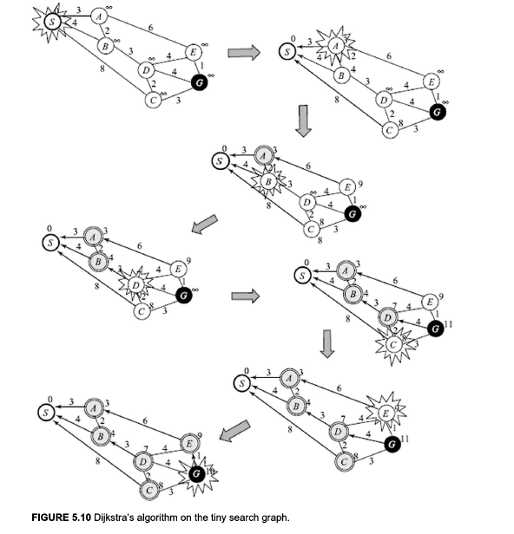

Slide 17
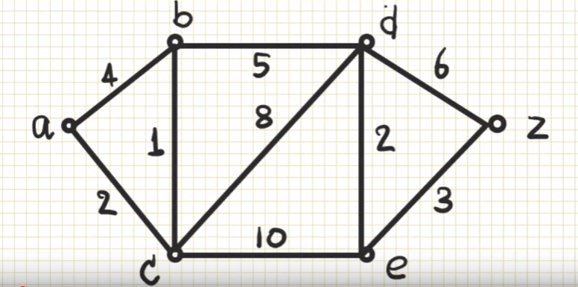
Calculate shortest path for this problem

